Slide 1
Agenda
Introductions
Racialization of Asians in the U.S.
History of Asian Americans
Asian America today
Questions and discussion

Slide 2
Asian American Resource Workshop
The Asian American Resource Workshop (AARW) is a political home for pan-Asian communities in Greater Boston. We are a member-led organization committed to building grassroots power through political education, creative expression, and issue-based and neighborhood organizing.
www.aarw.org

Slide 3
Anti-Displacement Framework
Housing
Criminalization
Tenant organizing, development without displacement, housing justice policies
Reducing and defunding police & prisons, community safety, surveillance (particularly in Muslim communities)
Immigration
Environment
Southeast Asian deportation, immigrant storytelling, undocumented Asian American communities
Massachusetts Green New Deal policies, environmental justice

Slide 4
What does “Asian American” mean?
People who are of Asian descent and live in the United States.
Includes ethnic groups like Cambodians, Vietnamese, Hmong, Chinese, Burmese, Japanese, Koreans, Filipinos, Asian Indians, and many more.
The term ‘Asian American’ came from the Civil Rights Movement (60s/70s) by student organizers who used the term to build power among different ethnic groups for their right to Ethnic Studies within the university.

Slide 5
How are Asian Americans seen?
Model Minority Myth
“Pet”
Perpetual Foreigner
“Threat”

Slide 6
How does racism function?
Ideological/Cultural
Institutional
A system of beliefs or ideas
Using the laws, the legal system, the education system, public policy, media, political power, etc… to maintain ideology
Interpersonal
Internalized
The idea that one person is better than another and has the right to dominate/control the other
The oppressor doesn’t have to exert any more pressure, because we now do it to ourselves and each other

Slide 7
Asian American History

Slide 8
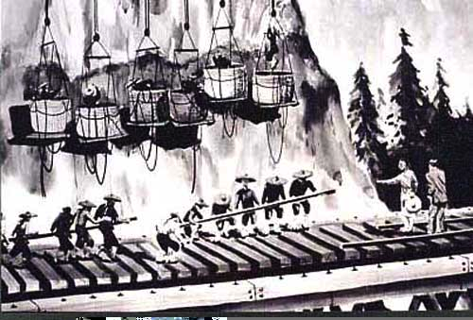
TRANSCONTINENTAL RAILROAD: 1860’s
Chinese men worked on the Transcontinental Railroad under grueling and dangerous conditions for less money than their white railroad workers.

Slide 9
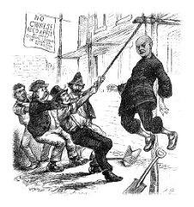
Strikes & Armed Rebellion against
Chinese Lynchings - 1848 to 1900s
As Chinese migrants moved into California they faced intense violence from white settlers, particularly by white workers who perceived Chinese people to be “stealing” their jobs. Chinese communities fought back through strikes, armed rebellion and lawsuits, refusing to carry mandatory identity cards, and organizing direct actions.

Slide 10
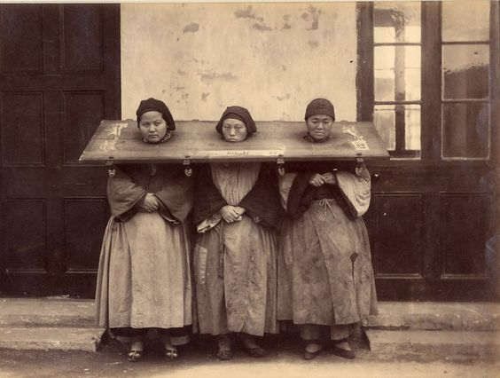
PAGE ACT OF 1875
This was the first piece of American legislation passed to restrict Asian immigration. This law prohibited “undesirable” individuals from entering the U.S, which targeted people from Asia and particularly Asian women, all of whom were thought to be prostitutes.

Slide 11
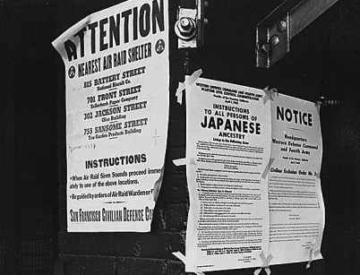
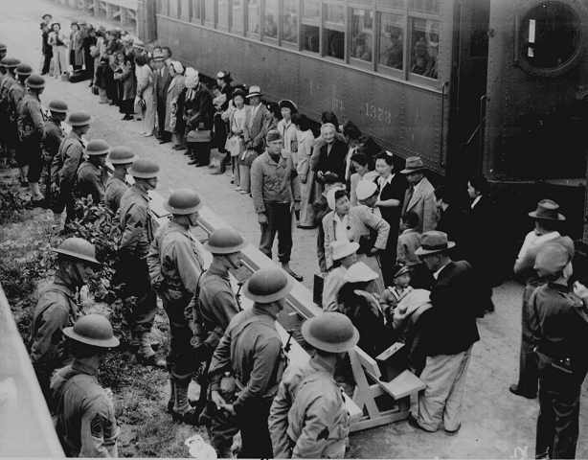
Resistance to Japanese Internment: 1942 – 1944
President Roosevelt authorized the incarceration of 120,000 Japanese Americans, most of whom were U.S. citizens, into internment camps in response to World War II. Many Japanese Americans resisted these orders through civil disobedience. Many others saw their livelihoods destroyed, their property taken away.
Notes:
perpetual foreigner

Slide 12
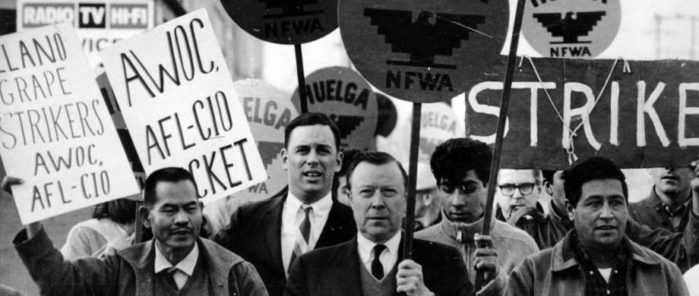
DELANO GRAPE STRIKE & BOYCOTT: 1965
With organizers Larry Itliong and Cesar Chavez, Filipino and Mexican migrant farm workers held one of the most successful American strikes and boycotts in Delano, California for better working conditions. In 1970, pressure from the ongoing boycott forced employers to sign contracts with workers to ensure that the demands were met.
Notes:
resistance to model minority myth /perpetual foreigner framework
solidarity with other poor and working class people of color
real wins!

Slide 13
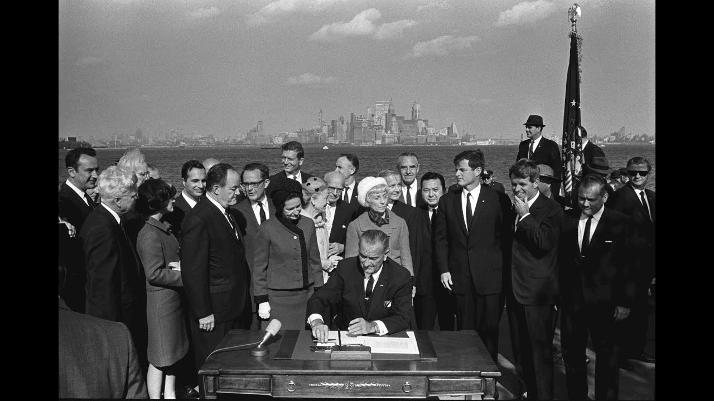
Hart-Celler Act of 1965
The Hart-Celler Act of 1965 abolished the national-origins quota system of immigration, replacing it with per-country caps and prioritized categories of immigrants (such as skilled, family, refugee, etc.). This number greatly increased the quota of Asian immigrants allowed into the country.
Notes:
The waves of Southeast Asian refugees and immigrants in the ‘60s and ‘70s, as well as immigration from South Asia and the Middle East, benefited from the opening of the immigration system that the Hart-Celler Act brought.
allowed the us to pick and choose “desirable” asians to immigrate
allowed a high-earning, educated class of asians to make their lives here
conditional

Slide 14
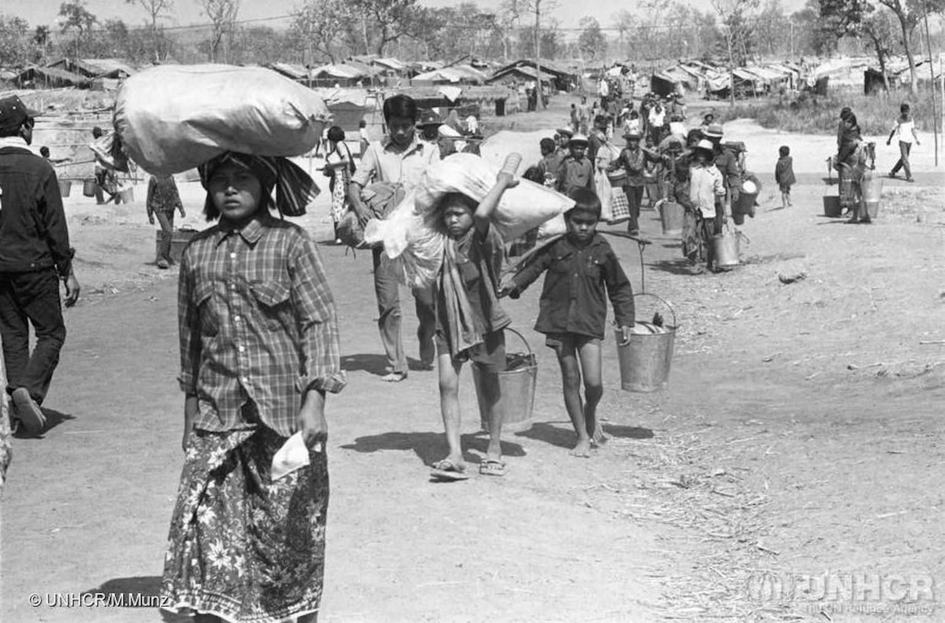
Refugee Resettlement Act: 1975
This act was passed on May 23, 1975, under President Gerald Ford, in response to the Fall of Saigon and the end of the Vietnam War. Under this act, approximately 130,000 refugees from South Vietnam, Laos and Cambodia were allowed to enter to the United States under a special status, and the act allotted for special relocation aid and financial assistance.

Slide 15
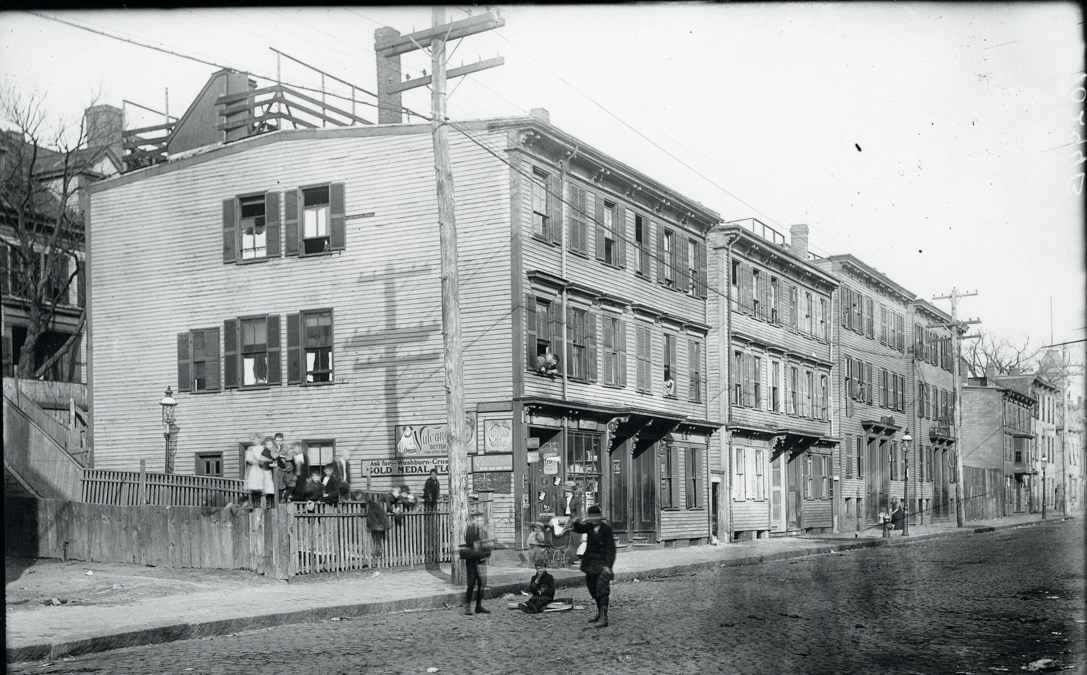
Refugee Resettlement in Dorchester: 1970s-1980s
Many Southeast Asian communities were resettled into East Boston, Chinatown, and Brighton as refugees. As rents were rising in these areas, the community started moving out of the city to surrounding neighborhoods - Dorchester (Fields Corner). At the same time, white people were migrating out to the suburbs, Black folks and Latinx folks were moving into Dorchester.

Slide 16
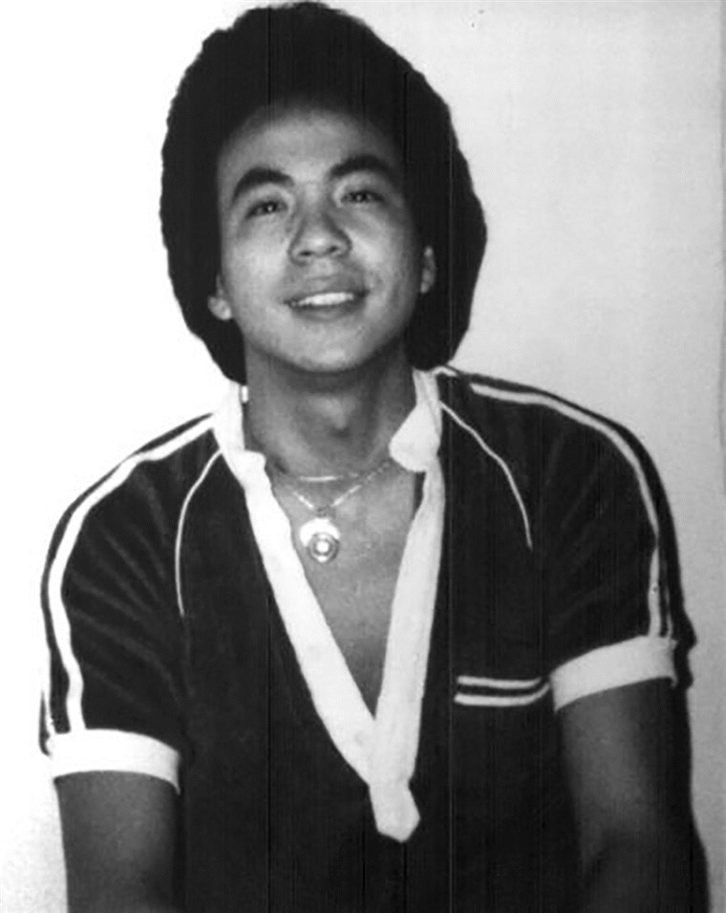
Killing of Vincent Chin: 1982
Vincent Chin was a Chinese person brutally murdered by 2 white workers, recently laid off from a car factory. They mistook Vincent for being Japanese, and were angry at Japanese carmakers for flooding the market with cheaper cars. They were let off with no jail time. This mobilized a massive response from Asian American community members.

Slide 17
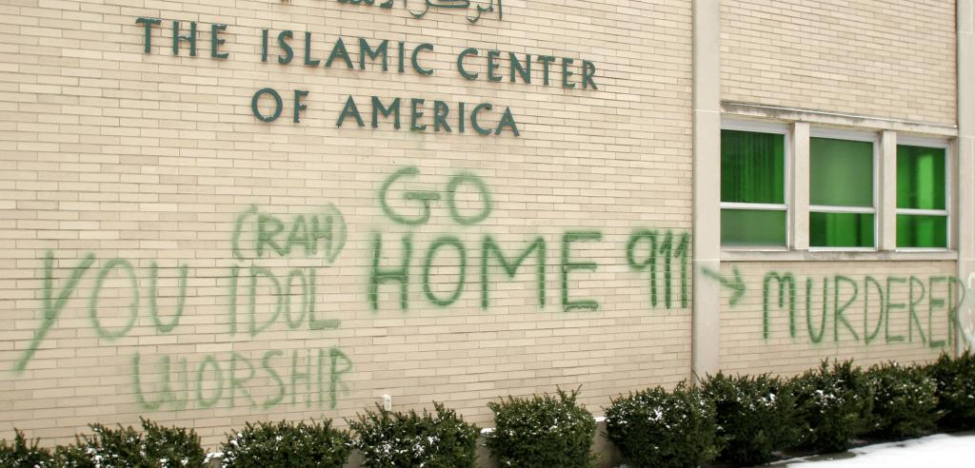
State violence after 9/11
After the September 11, 2011 attacks on the World Trade Center, there was a sharp increase in hate crimes and organized state violence against South Asians and Muslim Americans. Many police departments across the U.S. received funding to start “anti-terror” units used to harass and criminalize South Asians.

Slide 18
What is happening today
Across the country, we have seen an increase in anti-Asian violence in the political climate of the last period
Targeting in terms of political rhetoric
Similar to what we’ve seen in South Asian & Muslim communities since 9/11
We need policy changes to get at the root causes of violence
In MA we’ve seen:
Mostly verbal harassment
Also avoidance, being coughed at, some physical assault, some online, some barred from transportation

Slide 19
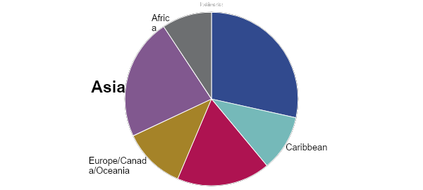
Almost 1/4 of unauthorized immigrants in Massachusetts are Asian.
Mexico and Central America
South America
Source: Migration Policy Institute, Profile of Unauthorized Population: Massachusetts, 2019
Notes:
Estimated 39,000 unauthorized immigrants from Asia in Massachusetts
China = 4th highest country of birth with an estimated 13,000 unauthorized immigrants, 7% of the statewide total
Impact this has on service access and provision, this was particularly clear during COVID-19

Slide 20
Income and educational attainment vary greatly across AAPI communities. Top 10 countries of ancestry for Asian Americans in Greater Boston. 2017.
Indian
Filipino
Taiwanese
Chinese
Japanese
Median Household Income
Korean
Vietnamese
Pakistani
Nepalese
Cambodian
Share with College Degree or More (25+ years old)
Notes:
Summary-esque slide– highlights the tremendous diversity and often very real disparities
Increased immigration from different regions of the world has led to increasing intra-group diversity/disparities
According to a McKinsey study, Asian Americans have the largest intra-racial income inequality of any racial group.

Slide 21
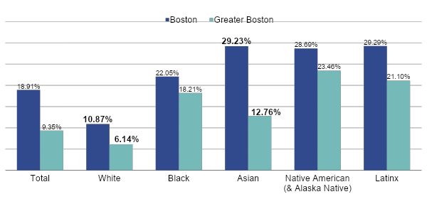
Asian poverty is 2x White poverty in Greater Boston and 3x White poverty in Boston. Poverty rates by race/ethnicity: Boston vs. Greater Boston (2019).
Source: American Community Survey 5-year Estimates 2015-2019

Slide 22
Discussion Questions
What connections do you see between the history of Asian American communities and your own community?
What surprised you? What stuck out to you?
What else do you feel curious about?
Que conexões você vê entre a história das comunidades asiático-americanas e sua própria comunidade?
O que te surpreendeu? O que chamou sua atenção?
Sobre o que mais você tem curiosidade?

